Slide 1
SOFTWARE PROCESSES

Slide 2
OBJECTIVES
To introduce software process models
To describe three generic process models and when they may be used
To describe outline of process models for requirements engineering, software development, testing and evolution
To explain the Rational Unified Process model
To introduce CASE technology to support software process activities

Slide 3
TOPICS COVERED
Software process models
Process iteration
Process activities
The Rational Unified Process
Computer-aided software engineering (CASE)

Slide 4
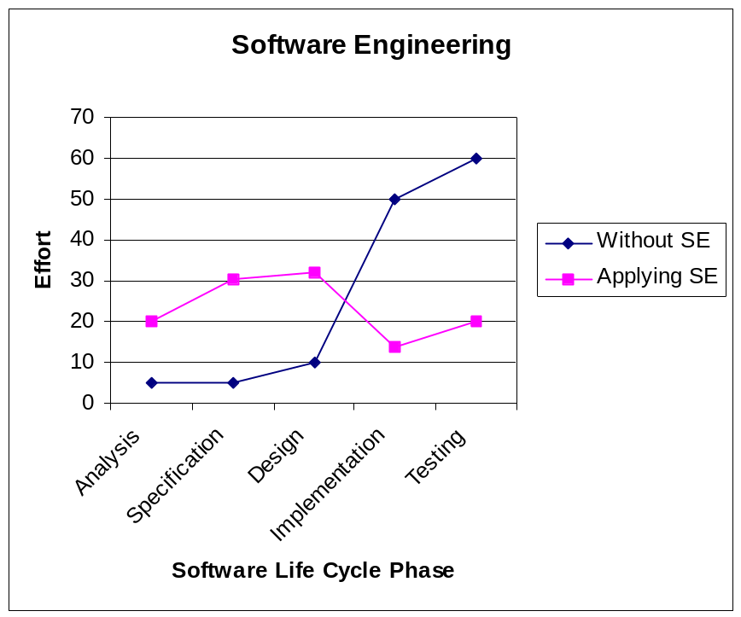
SOFTWARE LIFE CYCLE
The phases of a software development cycle.
⇨ Analysis:
⇨ Specification
⇨ Design
⇨ Implementation
⇨ Testing
⇨ Delivery/Maintenance

Slide 5
SOFTWARE LIFE CYCLE
Feasibility study – WHY? Cost benefit analysis (is it worth doing the project)
Requirements analysis + specification: WHAT? What should the software do, produce a document.
Design - How? How should the software do it. Architectural design (overall structures + organization of objects/modules, choice of data structures, etc.
Coding/Implementation: Realize ! components. Code modules, products: software,
Testing: Realize ! Test individual modules, test whether several modules work together, test system as a whole, document test results.
Deliver and maintenance : Evolve!

Slide 6
LAYERED VIEW OF SE
Layered approach:
  Process.
  Methods.
  Tools.
Software Engineering
Software Engineering
tools
methods
process model
a “quality” focus

Slide 7
THE SOFTWARE PROCESS
A structured set of activities required to develop a
software system
  Specification – defining what the system should do;
  Design and implementation – defining the organization of the system and implementing the system;
  Validation – checking that it does what the customer wants;
  Evolution – changing the system in response to changing customer needs.
A software process model is an abstract representation of a process. It presents a description of a process from some particular perspective.

Slide 8
SOFTWARE PROCESS MODELS
A software process model is a standardised format for planning, organising, and running a new development project.
A software life cycle model is either a descriptive or prescriptive characterization of how software is or should be developed.
Software process models represent a networked sequence of activities, objects, transformations, and events that embody strategies for accomplishing software evolution;

Slide 9
PLANNING WITH MODELS
SE projects usually live with a fixed financial budget. (An exception is maintainance?)
Additionally, time-to-market places a strong time constraint.
There will be other project constraints such as staff.

Slide 10
EXAMPLES OF PROJECT CONSTRAINTS
designers
programmers
managers
money
staff
Project constraints
Computing
resources
time
Notes:
SE projects usually live with a fixed financial budget. (An exception is maintainance?)
Additionally, time-to-market places a strong time constraint.
There will be other project constraints such as staff.

Slide 11
PLANNING WITH PROCESS MODELS
Project planning is the art of scheduling the necessary activities, in time, space and across staff in order to optimise:
project risk [low] (see later)
profit [high]
customer satisfaction [high]
worker satisfaction [high]
long-term company goals

Slide 12
GENERIC SOFTWARE PROCESS MODELS
The waterfall model
  Separate and distinct phases of specification and development.
Incremental development
  Specification, development and validation are interleaved. May be plan-driven or agile
Reuse-oriented software engineering
  The system is assembled from existing components. May be plan-driven or agile.

Slide 13
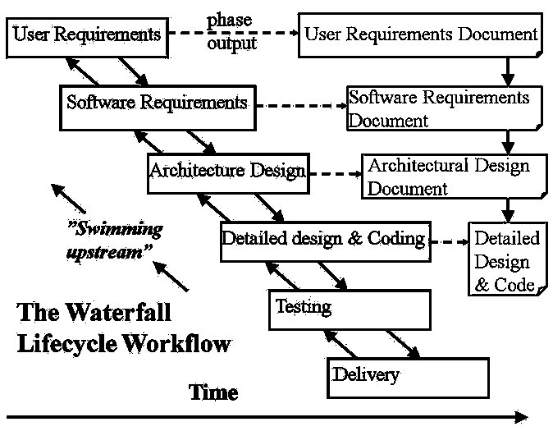
THE WATERFALL MODEL
Notes:
The waterfall model is the classic lifecycle model – it is widely known, understood and (commonly?) used.
In some respect, waterfall is the ”common sense” approach.
Introduced by Royce 1970.
SE is about process, what are the steps that people take to develop software and the process that we will be covering in class will be XP.
Here we have slides about the traditional software development process (the first one that was documented) known as waterfall.
When you try and visualize this it tries to describe how software development is done in the form of steps
Requirements: Figure out what your software should do. E.g Powerpoint, we want a software that allows us to make slides and give presentations. Ofcourse that is very high-level so we need to break that down and do refinement.
Design: Figure out how you will satisfy these requirements, organize your code, what are the modules that you are going to have, what classes are you going to use if you are in java, packages, methods. Usually this can be split up into high-level design and low-level design. Usually you have a high-level architecture for the entire system and smaller ones for the modules.
Implementation: You have the name of the classes and methods now you go and implement the bodies.
Integration: In design you split the modules, and different groups implement those modules. Integration tells you how to put these things together.
Maintenance: Once you are done with integration you can release and start selling your software earning a lot of money. If you are utube you can sell yourself to google for 4 million dollars and then give maintenance to someone else because you have enough to retire.
The way waterfall was originally described was without the back edges. So you froze each of your artifacts after each stage. In practice its very hard to freeze the requirements and never ever go back cause they are constantly changing. So waterfall was fixed to be iterative in the sense that once you do the requirements and start the design, you cycle back and start refining the requirements. Similarly once you started coding you may feel that the design has shortcomings and go and refine that.
So waterfall without the back edges is purely theoretical somethings which we teach only in classes and rarely followed in practise unless in very special cases where the requirements are very stable and they never change e.g defense contractors, making some software to deliver some rockets where things can be fixed especially if they tell you that you have 2 years to deliver the software.
In contrast what XP does is reverses the picture the other way around starting with testing.
Unlike other engineers (e.g. civil, electronic, chemical … etc.) software engineers do not produce anything physical.
It is inherently difficult to monitor an SE project due to lack of visibility.

Slide 14
ADVANTAGES
Easy to understand and implement.
Widely used and known (in theory!)
Reinforces good habits: define-before- design, design-before-code
Identifies deliverables and milestones
Document driven, … etc. Published documentation standards, e.g. PSS-05.
Works well on mature products and weak teams.

Slide 15
DISADVANTAGES I
Idealised, doesn’t match reality well.
Doesn’t reflect iterative nature of exploratory development.
Unrealistic to expect accurate requirements so early in project
Software is delivered late in project, delays discovery of serious errors.

Slide 16
DISADVANTAGES II
5. Difficult to integrate risk management
Difficult and expensive to make changes to documents, ”swimming upstream”.
Significant administrative overhead,
costly for small teams and projects.

